Slide 1

Lecture 1: Intro to Qiskit 1.0
Qiskit Global Summer School 2024
Abby Mitchell Developer Advocacy Lead IBM Quantum

Slide 2








Anatomy of a quantum computing service
Quantum programming language
User
Cloud service (Qiskit Runtime)
Server in laboratory
Pulse sequences
Control electronics
Quantum processor
Notes:
Focus = understanding the User -> Cloud Service part

Slide 3
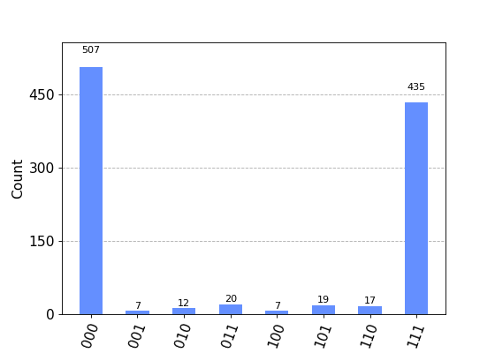
Example final result
Notes:
This is what we’re working up to in the presentation.

Slide 4





What is Qiskit?
Qiskit SDK is an open-source SDK for working with quantum computers at the level of extended quantum circuits, operators, and primitives.
https://github.com/Qiskit/qiskit
https://docs.quantum-computing.ibm.com/
Qiskit Runtime is a cloud-based service for executing quantum computations on IBM Quantum hardware.
https://github.com/Qiskit/qiskit-ibm-runtime https://docs.quantum-computing.ibm.com/
Runtime Primitives version 2 released March 2024 🎉
version 1.0 released Feb 2024 🎉
Qiskit Patterns is a framework for breaking down domain-specific problems into stages.
The Qiskit Ecosystem is a collection of software and projects that build on or extend Qiskit.
http://qiskit.github.io/ecosystem
Notes:
Qiskit = suite of technologies to do useful quantum computing
Fun fact: Qiskit = Quantum Information Science Kit

Slide 5
Getting set up with Qiskit
pip install 'qiskit[visualization]'
pip install qiskit-ibm-runtime
To access IBM hardware, set up your credentials through one of:
IBM Quantum Platform
IBM Cloud
https://docs.quantum-computing.ibm.com/start

Slide 6
Qiskit Patterns
1. Map problem to quantum circuits and operators
2. Optimize circuits for target hardware
3. Execute on target hardware
4. Postprocess results

Slide 7
Qiskit Patterns
1. Map problem to quantum circuits and operators
2. Optimize circuits for target hardware
3. Execute on target hardware
4. Postprocess results

Slide 8
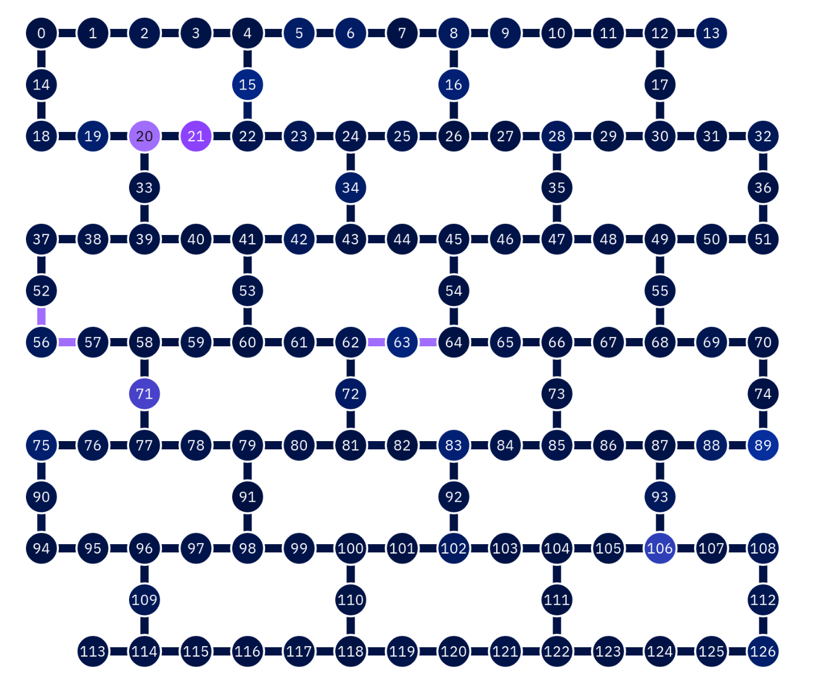
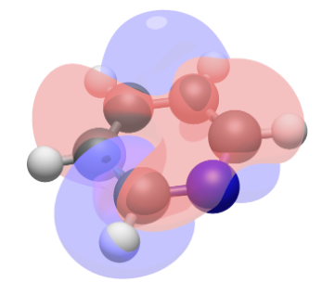

To map a problem:
Start with numerical representation
Map to quantum computing representation
Choose quantum algorithm
Notes:
Disclaimer: this is a rich topic
Step 1: how to represent numerically, like quantum mechanics for nature and chemistry simulation
Step 2: map that numerical representation to quantum computing. assigning each orbital to specific qubits
- Example: represent a molecule by assigning each orbital to specific qubits and thinking about how to define the operators for transformations like creation and annihilation
Step 3: example algorithms: VQE or quantum phase estimation

Slide 9
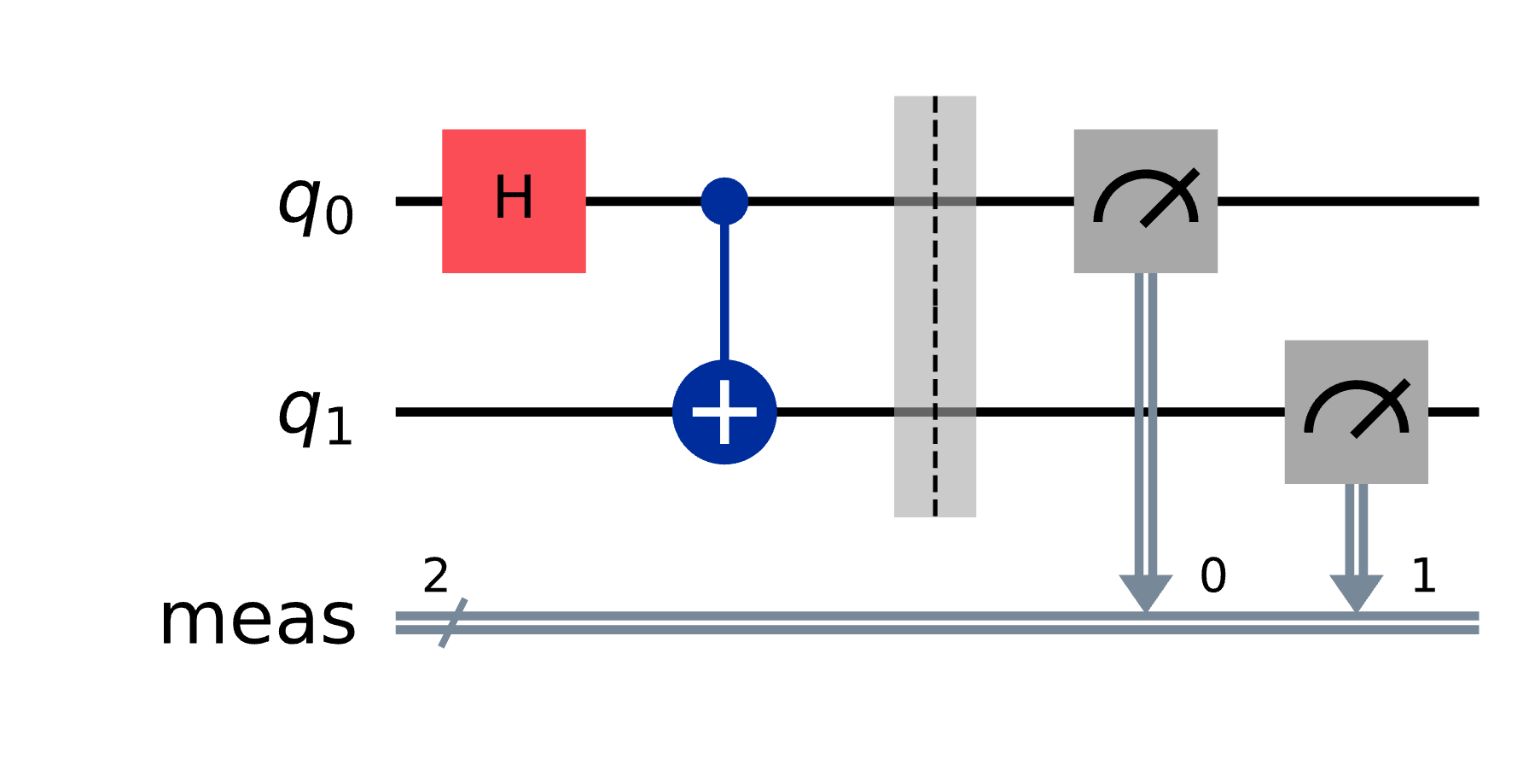
Build a circuit with Qiskit SDK
The foundation of quantum programs are quantum circuits.
They consist of operations—including gates, measurement, and reset—that manipulate qubits.

Slide 10
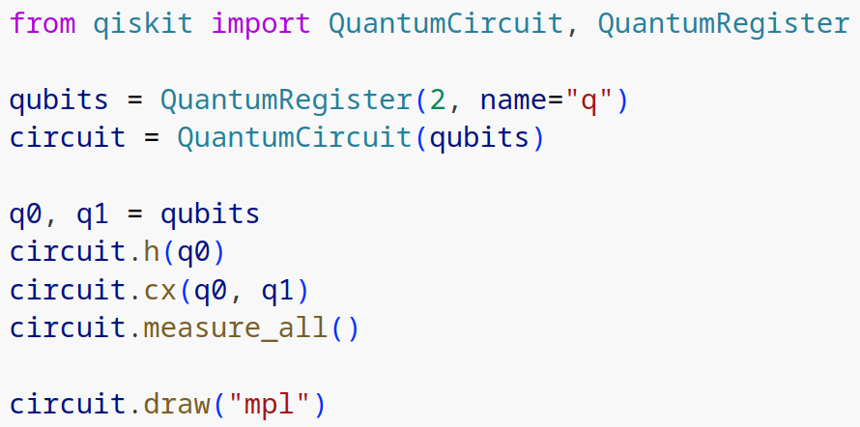
Build a circuit with Qiskit SDK
To build a circuit:
Initialize a register of qubits
Add the qubits to a circuit
Perform operations on those qubits

Slide 11
Qiskit SDK includes a library of standard gates and circuits.
Standard gates
Hadamard, Pauli rotation gates, CNOT, Quantum Fourier Transform, etc.
Variational ansatzes
Parameterized quantum circuits for chemistry and combinatorial optimization, including hardware efficient ansatzes
Notes:
Ansatz = prebuilt circuit but you can change the parameters
Also other tools like benchmarking circuits & building your own gates/operators

Slide 12
Qiskit Patterns
1. Map problem to quantum circuits and operators
2. Optimize circuits for target hardware
3. Execute on target hardware
4. Postprocess results

Slide 13
Optimize for hardware – techniques
Required: transpile your abstract circuit into a circuit that can run on target hardware.
Optional: verify your circuit with simulation.

Slide 14
Optimize for hardware – techniques
Required: transpile your abstract circuit into a circuit that can run on target hardware.
Optional: verify your circuit with simulation.

Slide 15


Basis gate set
Only a limited set of gates can be executed directly on the hardware. Other gates must be rewritten in terms of these basis gates.
Qubit connectivity
Only certain pairs of qubits can be directly interacted with each other.
Errors
Each operation has a chance of error, so circuit optimizations can greatly affect performance.
Real quantum devices are subject to constraints
Notes:
Qubit connectivity = ex. Qubit 0 and qubit 7 in a two-qubit gate, but on hardware they are not actually connected to each other. The way that is solved is with inserting swap gates

Slide 16
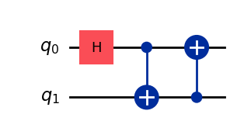
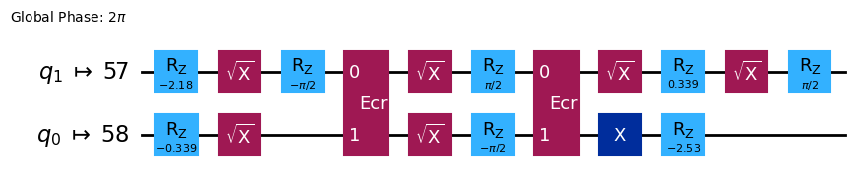
Challenge: run abstract circuit on a specific quantum device.
Solution: transpilation —
convert abstract circuit into an ISA (instruction set architecture) circuit.
Notes:
Inspired by compilation, but not quite the same because you get back a circuit not machine code. Converting to pulse sequences is done with the cloud service
FYI: ECR gate = echo cross resonance, implements C-not

Slide 17
Transpilation terms
Term | Definition | Orchestra analogy
pass | a standalone circuit or metadata transformation | an instrument
pass manager | a list of transpiler passes grouped into a logical unit | an instrument section
staged pass manager | a list of pass managers, with each one representing a discrete stage of a transpilation pipeline | the conductor

Slide 18
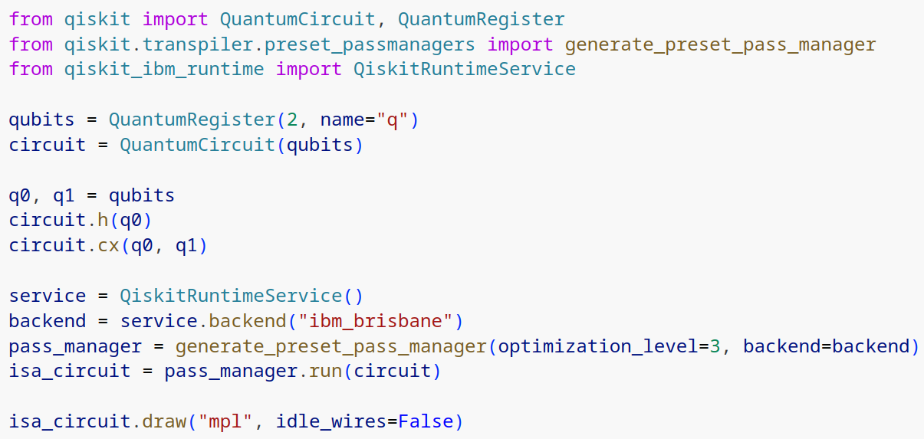
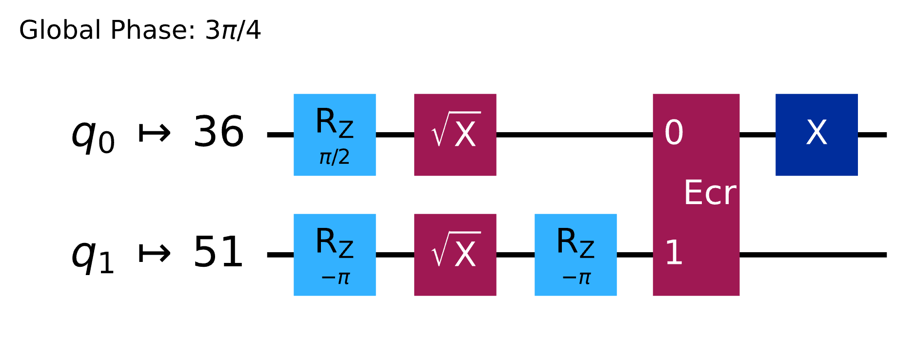
Transpile a circuit with Qiskit SDK
Steps:
Choose which device backend you want to target
Create a preset staged pass manager with your desired optimization level
Run the staged pass manager on the circuit

Slide 19
Transpiler stages
1. Initialization
The circuit is prepared for transpilation, e.g., multi-qubit gates are decomposed into two-qubit gates.
2. Layout
The abstract qubits of the circuit are mapped to physical qubits on the device.
3. Routing
Swap gates are inserted to enable interactions between qubits that are not physically connected.
4. Translation
The gates of the circuit are translated to the basis gate set of the device.
5. Optimization
The circuit is rewritten to minimize its depth (# of operations) to decrease the effect of errors.
6. Scheduling
Delay instructions are added to align the circuit with the hardware’s timing.

Slide 20
Additional transpilation tools
Qiskit transpiler service
Qiskit Ecosystem, e.g., circuit-knitting-toolbox
Write your own transpiler plugins
20
Notes:
Qiskit transpiler service is only for premium users
Why would you write your own? If you’re not satisfied with something you’ve found, or you come up with a particular clever way to decompose your circuit or problem

Slide 21
Optimize for hardware – techniques
Required: transpile your abstract circuit into a circuit that can run on target hardware.
Optional: verify your circuit with simulation.

Slide 22
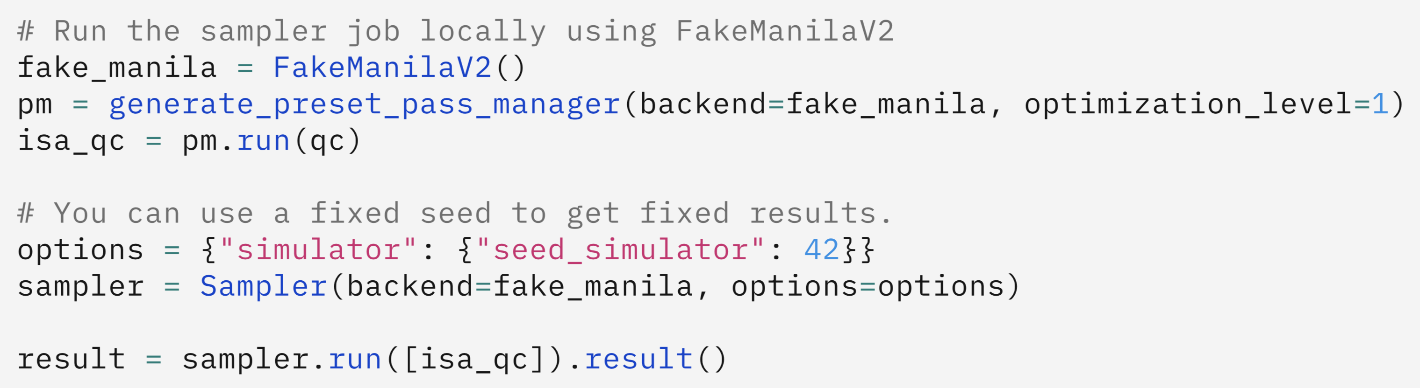
Simulation tools
Qiskit SDK reference primitives
Exact simulation, but small circuits only and no noise simulation.
Qiskit Runtime local testing
Provides “fake” backends to model each quantum machine.
Qiskit Aer
Ecosystem project for simulation, including
larger circuits
stabilizer circuits
noise models
Notes:
With Aer: stabilizer circuit = circuit that is particularly effective to simulate even at larger scales
Why run on actual hardware if you can simulate? If it can run on classical, you don’t need quantum in the first place. You use quantum because of scaling / utility-scale work. Testing/simulation is only a technique before running on hardware.
Another motivation for running on hardware is to prep
If I have Clifford circuits, why use quantum computer? The gate set for Clifford circuits is quite limited. If you can fully represent your problem with it, then not much benefit from QC. But many problems can’t be represented by Clifford circuit.

Slide 23
Problem: the runtime cost of simulating quantum circuits scales exponentially with the number of qubits. ~50+ qubits cannot be simulated.
Techniques for large circuits:
Test smaller versions of circuit
Modify circuit so that it becomes classically simulatable: stabilizer circuit aka Clifford circuit
Notes:
Both techniques are non-trivial Testing smaller circuits: e.g. simulate a smaller lattice when you’re using lattice models.
Some downsides to modifying to Clifford circuit that it may not be representative anymore (prepare the state you want)

Slide 24
Qiskit Patterns
1. Map problem to quantum circuits and operators
2. Optimize circuits for target hardware
3. Execute on target hardware
4. Postprocess results

Slide 25
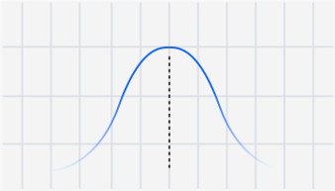
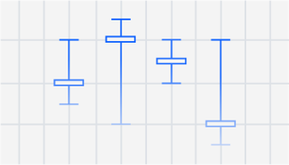
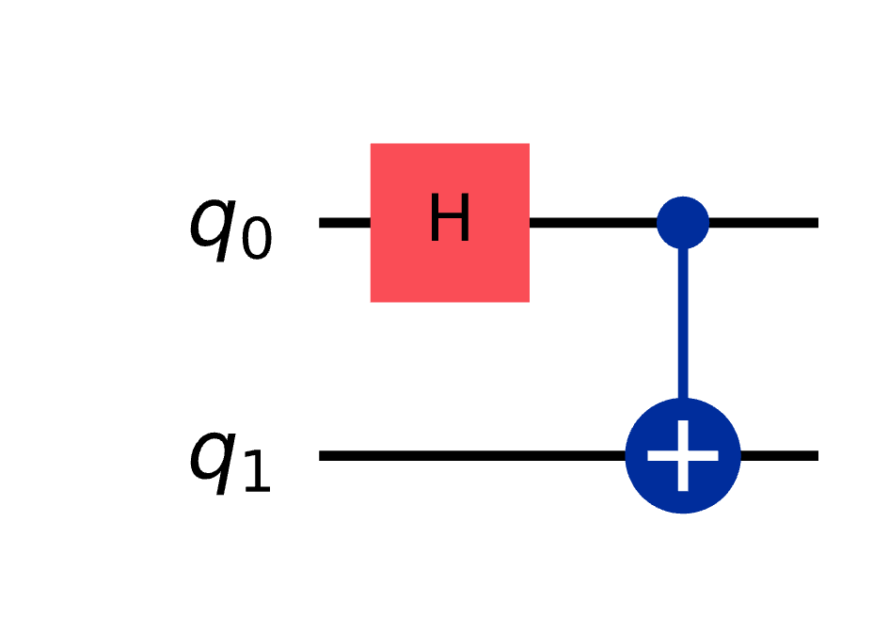
Primitives encapsulate the output of a quantum circuit
Sampler primitive
Estimator primitive
Output is mapping of bitstrings to counts, e.g.,
{'0': 12, '1': 9}
Circuit should include measurements.
Output is the expectation value of an observable, e.g., the net spin of a system.
Circuit should not include measurements.
Notes:
Expectation value = average value of an observable quantity
Observable = a physical quantity you are measuring, like the Pauli operators to measure the spin of a qubit

Slide 26
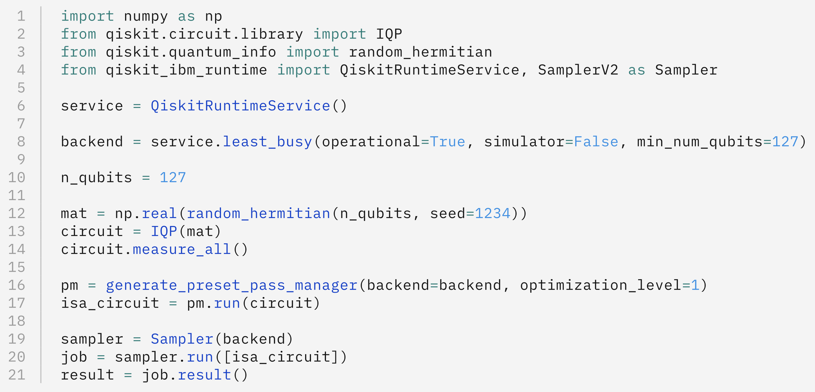
To run a circuit on quantum hardware:
Initialize the Qiskit Runtime service
Choose a hardware backend
Initialize a Qiskit Runtime primitive with your chosen backend
Invoke the primitive with your circuit
Notes:
IQP = instantaneous quantum polynomial circuit
Has a bunch of T gates, Hadamard gates etc

Slide 27
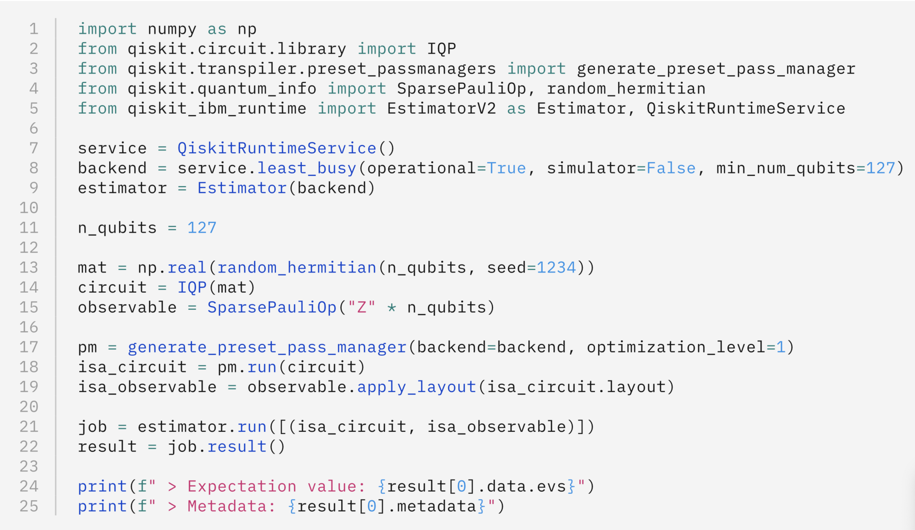
The input to the Estimator primitive is a list of primitive unified blocs (PUBs). Each PUB consists of:
A single circuit without measurements
One or more observables
(Optional) One or more parameter values
Notes:
Line 15 is an example observable: measure spin in the z-axis
Mention Sampler can also take input as a PUB if e.g. have a list of parameters

Slide 28
Shots
The number of measurements.
More shots reduce statistical error but increase running time.
Error suppression
Use dynamical decoupling to reduce decoherence during execution.
Caveat: requires delays between gate executions, so it’s not always possible.
Error mitigation
Reduce the effects of device noise after execution.
Twirled Readout Error eXtinction (TREX) measurement twirling
Zero Noise Extrapolation (ZNE)
Downside: computational overhead
You can customize Qiskit Runtime behavior
Notes:
Dynamical decoupling = inserts specific set of pulse sequences to reduce decoherence.

Slide 29
Execution modes
Single job
Batch: multiple concurrent jobs
Session: iterative workload

Slide 30
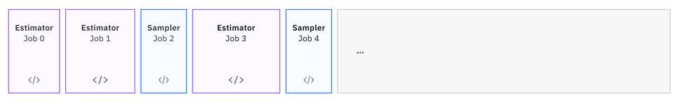
Benefits of batch mode versus a single job with multiple circuits:
better concurrency of classical processing
get individual results sooner

Slide 31
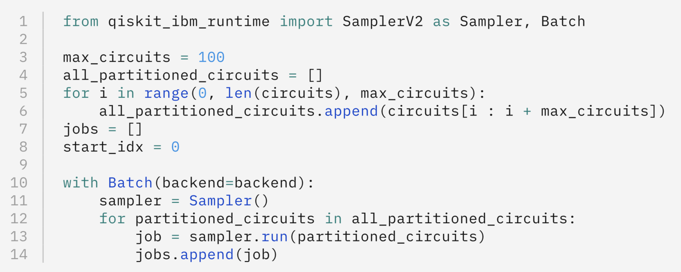
Batch mode
Notes:
Use a context manager (with statement)

Slide 32
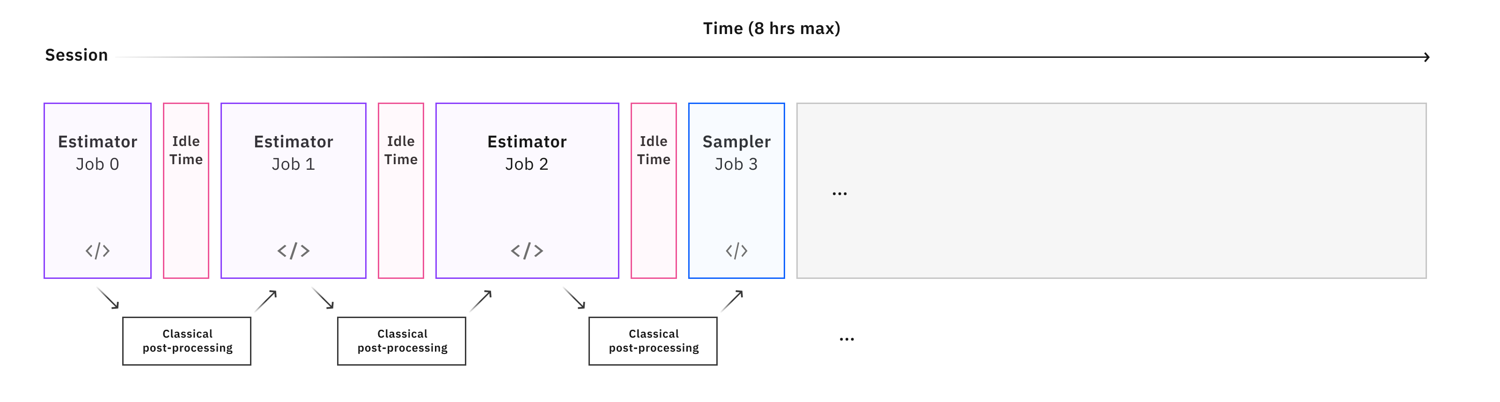
Sessions allow iterative workloads, like VQE.
Notes:
Advantage: less queue time between jobs

Slide 33
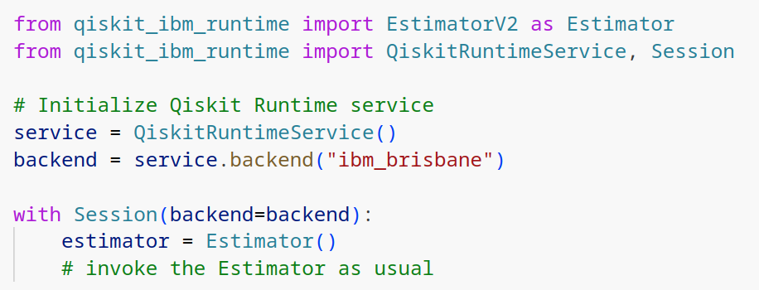
Sessions
Notes:
Create with context manager (with statement), like Batch mode

Slide 34
Qiskit Patterns
1. Map problem to quantum circuits and operators
2. Optimize circuits for target hardware
3. Execute on target hardware
4. Postprocess results
Notes:
Mention it’s often very specific to your problem.
FYI: Fourier transform

Slide 35
Postprocess technique: visualize results
With Sampler output, use plot_histogram() from qiskit.visualizations
Notes:
Mention that for Estimator you can visualize standard error with error bar plots from matplotlib

Slide 36
Postprocess technique: post-selection
Discard outputs known to be incorrect based on prior knowledge, e.g., if you know outputs must match a certain pattern
["1111", "1010", "1010", "1110"]
["1010", "1010", "1110"]
Notes:
real world is usually the # of odds vs evens
FYI: only relevant for Sampler

Slide 37
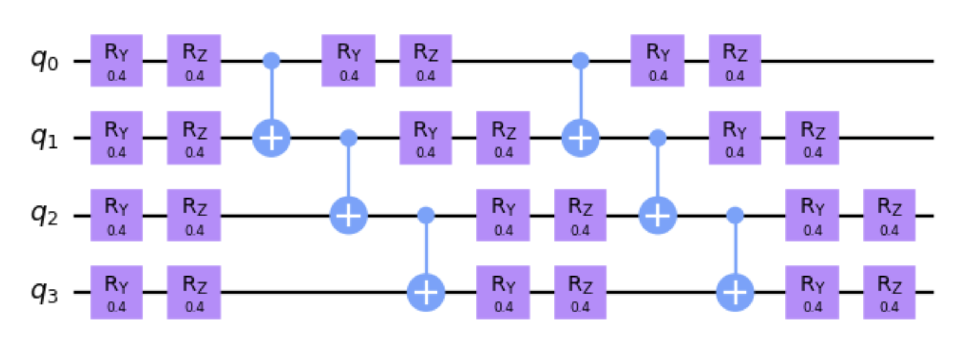
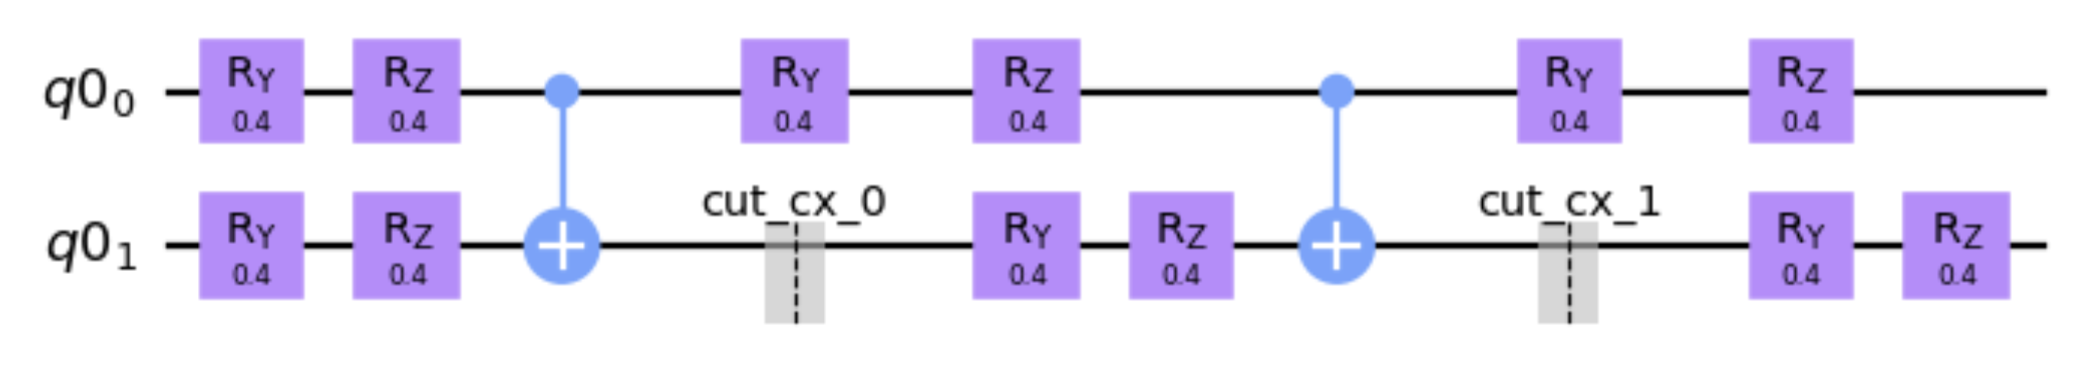
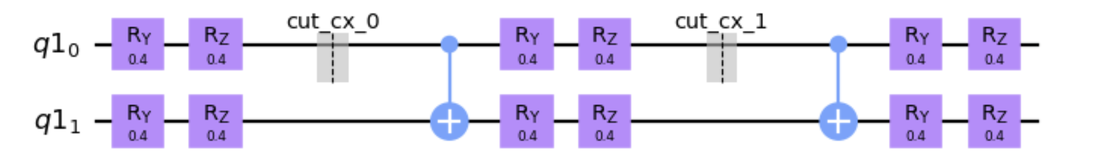
Postprocess technique: circuit knitting
During the optimize for hardware step, decompose the problem into smaller circuits, i.e., “circuit cutting”.
Execute smaller circuits.
“Knit” the results into a reconstruction of the original circuit’s outcome.
Notes:
Allows running larger circuits on smaller hardware, e.g., 400-qubit system on 127-qubit hardware.
gate cutting and wire cutting

Slide 38
Qiskit Patterns
1. Map problem to quantum circuits and operators
2. Optimize circuits for target hardware
3. Execute on target hardware
4. Postprocess results
Notes:
This is conclusion slide: recap the framework.

Slide 39
docs.quantum.ibm.com
Documentation for Qiskit and IBM Quantum services.
learning.quantum.ibm.com
Courses on quantum computing and how to use IBM Quantum services to solve real-world problems.
www.youtube.com/qiskit
Lectures, tips & tricks, tutorials, community updates, and exclusive Qiskit content!

